Slide 1
TFIP-AI Machine Learning
Unit 9 Naïve Bayes Classifier

Slide 2
Outline
Probability – a quick review
Spam Detection – Binary-class Classification Problem
Maximum Likelihood Estimate
Naïve Bayes
Multi-class problem

Slide 3
Probability - Refresh
TFIP-AI – Machine Learning

Slide 4
Independent Event
Coin flip
Head P(H)=0.5
Tail P(T)=0.5
Head P(H)=0.25
Tail P(T)=0.75
P(H)=0.5 P(H H H)=?
Xi：result of the i-th flipping, P(H)=0.5
P(X1=X2=X3=X4)=?
P({X1 X2 X3 X4} >=3 Heads)=？
complementary event
P(A)=p P(~A)=1-p
Independent event
X and Y are independent P(X)P(Y)=P(XY)

Slide 5
Independent Event
Coin flip
Head P(H)=0.5
Tail P(T)=0.5
Head P(H)=0.25
Tail P(T)=0.75
P(H)=0.5
P(H H H) = P(H) P(H) P(H) = 0.5*0.5*0.5 = 0.125
P(H)=0.5
Xi：result of the i-th flipping
P(X1=X2=X3=X4) = P(H H H H) + P(T T T T) = 0.5 * 0.5 * 0.5 * 0.5 + 0.5 * 0.5 * 0.5 * 0.5
P({X1 X2 X3 X4} >=3 Heads)= P(H H H H) + P(H H H T) + P(H H T H) + P(H T H H) + P(T H H H) = 5 * 0.5 * 0.5 * 0.5 * 0.5

Slide 6
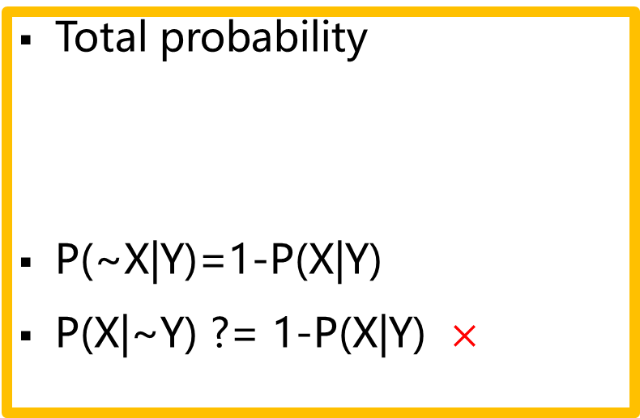
Dependence
First flip a fair coin,
P(X1=H)=0.5
If X1=H, then flip a loaded coin
P(X2=H|X1=H) = 0.9
If X1=T, then flip another loaded coin,
P(X2=T|X1=T) = 0.8
P(X2=H)=?
Total probability
P(~X|Y)=1-P(X|Y)
P(X|~Y) ?= 1-P(X|Y) $×$

Slide 7
Dependence
Three coins, a fair coin and two different loaded coins
First flip a fair coin,
P(X1=H)=0.5
If X1=H, then flip a loaded coin
P(X2=H|X1=H) = 0.9
If X1=T, then flip another loaded coin,
P(X2=T|X1=T) = 0.8
P(X2=H) =
P(X2=H|X1=H)P(X1=H) +
P(X2=H|X1=T)P(X1=T) =
0.9 * 0.5 + 0.2 * 0.5

Slide 8
Cancer Test
P(C)=0.01
P(~C)=？
P(+|C)=0.9
P(-|C)=?
P(+|~C)=0.2
P(-|~C)=0.8
P(+,C)=?
P(-,C)=?
P(+,~C)=?
P(-,~C)=?
P(C|+)=?
Notes:
0.99
0.1
0.009
0.001
0.198
0.792 0.009/0.207=0.043
先验概率很小，因此导致后验概率的值也很小

Slide 9
Cancer Test
P(C)=0.01
P(~C)=1-0.01=0.99
P(+|C)=0.9
P(-|C)=1-0.9=0.1
P(+|~C)=0.2
P(-|~C)=1-0.2=0.8
P(+,C)=P(+|C)P(C)=0.9*0.01
P(-,C)= P(-|C)P(C)=0.1*0.01
P(+,~C)=P(+|~C)P(~C)=0.2*0.99
P(-,~C)=P(-|~C)P(~C)=0.8*0.99
P(C|+)=?
Notes:
0.99
0.1
0.009
0.001
0.198
0.792 0.009/0.207=0.043
先验概率很小，因此导致后验概率的值也很小

Slide 10
Bayes Rule
A: Not observable
B: Observable
Diagnose Reasoning:
P(A|B)
P(A|~B)
How many parameters?

Slide 11
Likelihood vs Probability
Probability corresponds to finding the chance of something given a sample distribution of the data
Likelihood refers to finding the best distribution of the data given a particular value of some feature or some situation in the data.

Slide 12
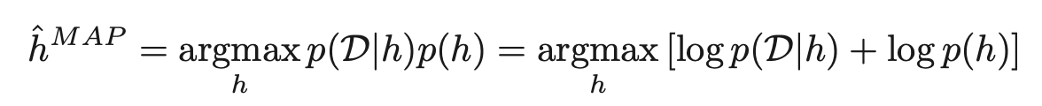
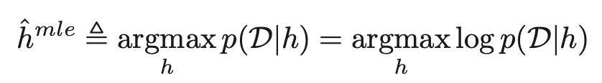
Naïve Bayes' Classifier
Note that the MAP(Maximum a posteriori estimation) estimate can be written as:
Since the likelihood term depends exponentially on N, and the prior stays constant, as we get more and more data, the MAP estimate converges towards the maximum likelihood estimate or MLE:
In other words, if we have enough data, we see that the data overwhelms the prior.
Notes:
As taking a product of some numbers less than 1 would approaching 0 as the number of those numbers goes to infinity, it would be not practical to compute, because of computation underflow. Hence, we will instead work in the log space, as logarithm is monotonically increasing, so maximizing a function is equal to maximizing the log of that function.

Slide 13
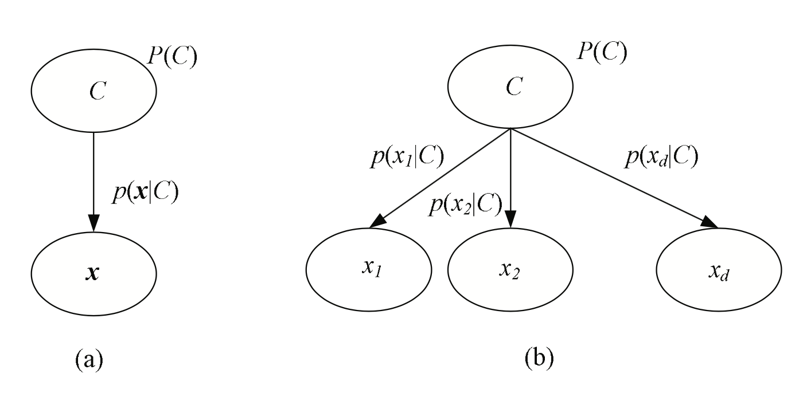
Naïve Bayes' Classifier cont...
Figure: (a) Graphical model for classification. (b) Naive Bayes’ classifier assumes independent inputs.

Slide 14
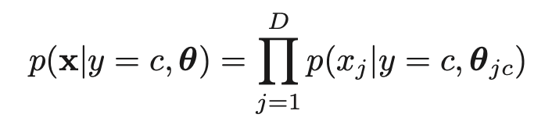
Naïve Bayes' Classifier cont...
The simplest approach is to assume the features are conditionally independent given the class label. This allows us to write the class conditional density as a product of one-dimensional densities:
The resulting model is called a naive Bayes classifier (NBC).

Slide 15
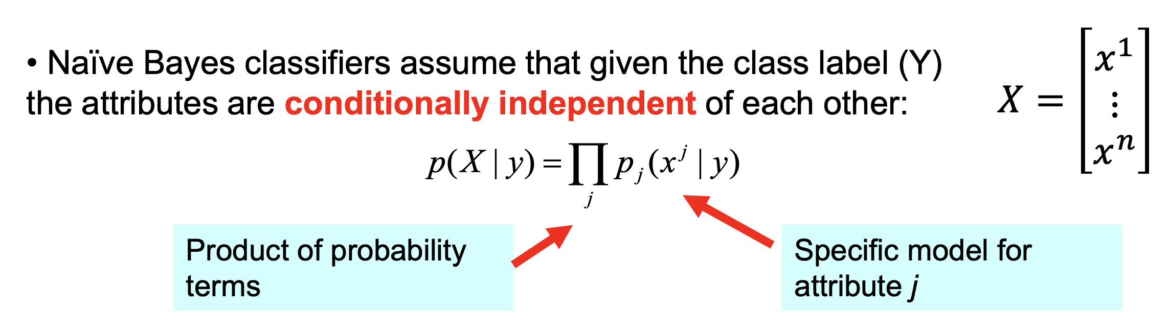
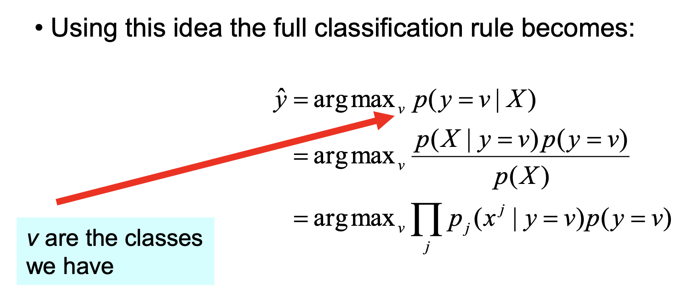
Naïve Bayes' Classifier cont...

Slide 16
Spam Detection
TFIP-AI – Machine Learning

Slide 17
Bag of Words
Msg1: {Hello I will say hello!}
Msg2: {Hello World}
Vocabulary
Hello 3
I 1
Will 1
Say 1
World 1
Term Frequency: Count of term in each message
 | Hello | I | Will | Say | World
Msg1 | 2 | 1 | 1 | 1 | 0
Msg2 | 1 | 0 | 0 | 0 | 1
tf(hello,msg1) = 2

Slide 18

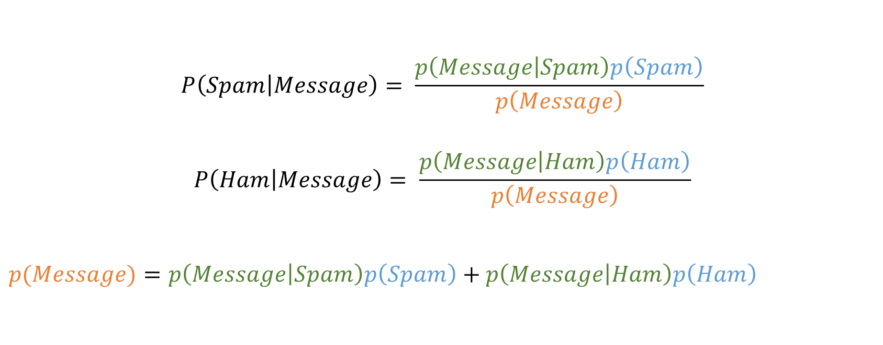
Spam Detection – Bayes Rule
$$P\left(Spam | Message\right)= \frac{p\left(Message | Spam\right)p\left(Spam\right)}{p\left(Message\right)}$$
$$P\left(Ham | Message\right)= \frac{p\left(Message | Ham\right)p\left(Ham\right)}{p\left(Message\right)}$$
$p(Message)=$ $p\left(Message | Spam\right)p\left(Spam\right)+p\left(Message | Ham\right)p\left(Ham\right)$
$$Ham is \sim Spam$$

Slide 19

Spam Detection – Training Data
$$p\left(Spam\right)$$
Spam
Ham
Offer is secret
Click secret link
Secret sports link
Play sports today
Went play sports
Secret sports event
Sport is today
Sport costs money
1. Size of vocabulary? 12
2. P(Spam) = ? 3/8

Slide 20
Maximum Likelihood Estimate (1)
$$p\left(Spam\right)$$
SSSHHHHH
P(S)=Π
I.ID: Independent, Identical Distribution
11100000

Slide 21

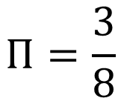
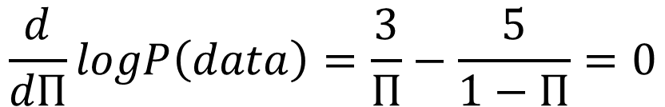
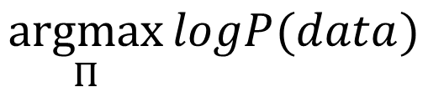
Maximum Likelihood Estimate (2)
$$p\left(Spam\right)$$
$$logP\left(data\right)=3logΠ+5log⁡(1−Π)$$
$$\underset{Π}{argmax}{logP(data)}$$
$$\frac{d}{dΠ}logP\left(data\right)=\frac{3}{Π}−\frac{5}{1−Π}=0$$
$$Π=\frac{3}{8}$$

Slide 22
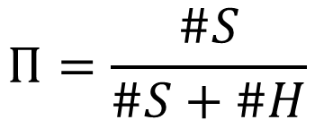
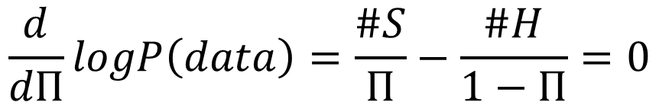
Maximum Likelihood Estimate
$$p\left(Spam\right)$$
$$logP\left(data\right)=(\#S)logΠ+(\#H)log⁡(1−Π)$$
$$\underset{Π}{argmax}{logP(data)}$$
$$\frac{d}{dΠ}logP\left(data\right)=\frac{\#S}{Π}−\frac{\#H}{1−Π}=0$$
$$Π=\frac{\#S}{\#S+\#H}$$

Slide 23
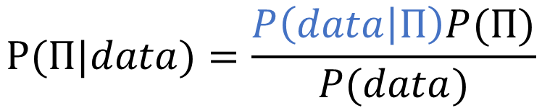
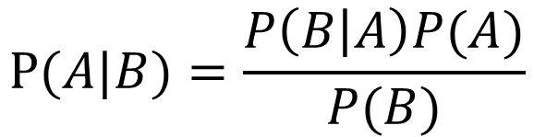
Likelihood
Machine learning task
Given dataset, estimate parameters
Prior
Posterior
$$P(A|B)=\frac{P\left(B | A\right)P(A)}{P(B)}$$
$$P(Π|data)=\frac{P\left(data | Π\right)P(Π)}{P(data)}$$
Likelihood
Maximize it

Slide 24
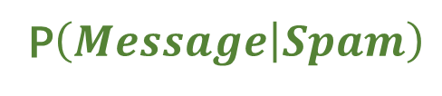
MLE Solutions for conditional probability
P$\left(Message | Spam\right)$
Spam
Ham
Offer is secret
Click secret link
Secret sports link
Play sports today
Went play sports
Secret sports event
Sport is today
Sport costs money
P(“Secret money”|Spam)

Slide 25
Why naïve?
P$\left(Message | Spam\right)$
Spam
Applying MLE, 0 message contain both ‘secret’ and ‘money’
However, 3 message contain ‘secret’
It’s hard to find those messages in training dataset which contain all words in the new message
Offer is secret
Click secret link
Secret sports link
P(“Secret money”|Spam)

Slide 26
Spam Detection – Naïve Bayes
P$\left(Message | Spam\right)$
P(“Secret money”|Spam) = P(“Secret”|Spam) P(“money”|Spam)
Conditional Independence
Learn P(word|Spam) from the training data by using Maximum Likelihood

Slide 27

MLE Solutions for conditional probability
$$p\left(Message | Spam\right)$$
Spam
Ham
Offer is secret
Click secret link
Secret sports link
Play sports today
Went play sports
Secret sports event
Sport is today
Sport costs money
1 P(“Secret”|Spam) =1/3
2 P(“Secret”|Ham) = 1/15

Slide 28
Spam
Ham
Offer is secret
Click secret link
Secret sports link
Play sports today
Went play sports
Secret sports event
Sport is today
Sport costs money

Slide 29
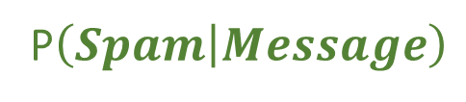
MLE Solutions for detection
P$\left(Spam | Message\right)$
Spam
Ham
Offer is secret
Click secret link
Secret sports link
Play sports today
Went play sports
Secret sports event
Sport is today
Sport costs money
1 P(Spam|“Sports”) =1/6
2 P(Spam|“Secret is secret”) =25/26

Slide 30
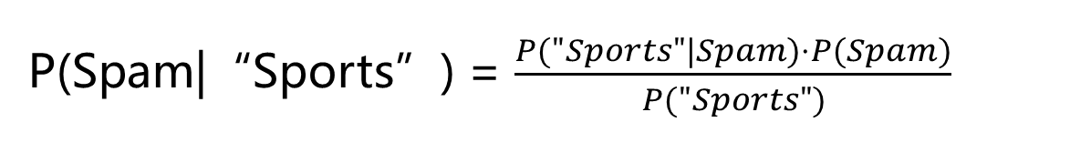
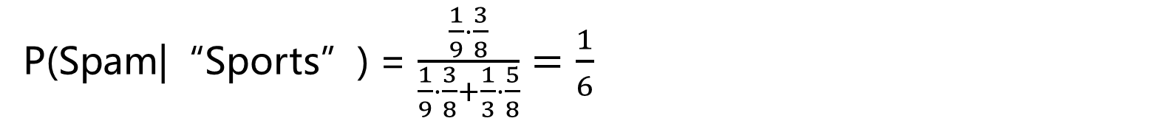
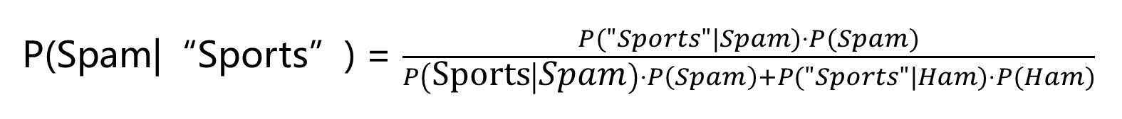
MLE Solutions for detection
P$\left(Spam | Message\right)$
P(Spam|“Sports”) = $\frac{P("Sports"|Spam)⋅P(Spam)}{P("Sports")}$
P(Spam|“Sports”) = $\frac{P("Sports"|Spam)⋅P(Spam)}{P\left(\text{Sports} | Spam\right)⋅P\left(Spam\right)+P("Sports"|Ham)⋅P(Ham)}$
P(Spam|“Sports”) = $\frac{\frac{1}{9}⋅\frac{3}{8}}{\frac{1}{9}⋅\frac{3}{8}+\frac{1}{3}⋅\frac{5}{8}}=\frac{1}{6}$

Slide 31
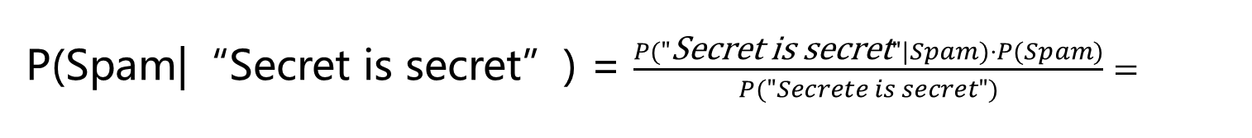
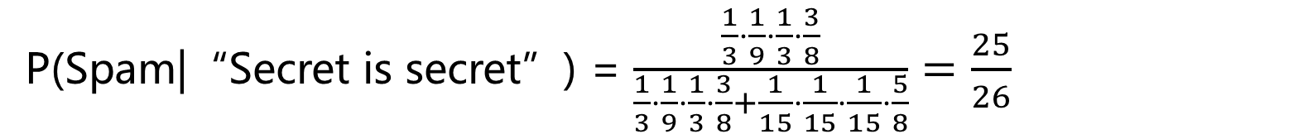
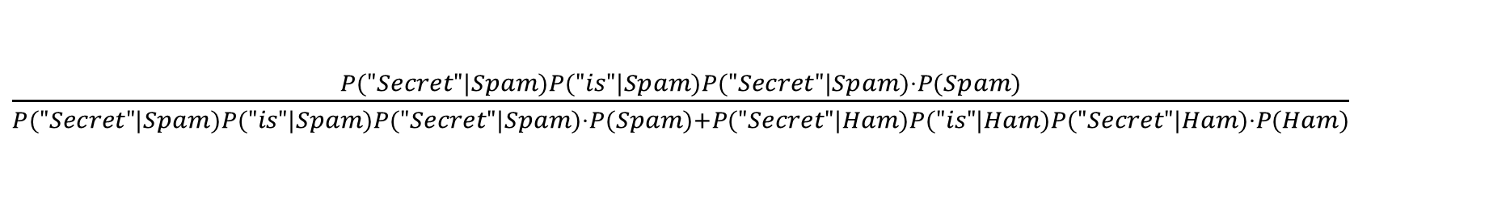
MLE Solutions for detection
P$\left(Spam | Message\right)$
P(Spam|“Secret is secret”) = $\frac{P("\text{Secret} \text{is} \text{secret}"|Spam)⋅P(Spam)}{P("Secrete is secret")}=$
$\frac{P("Secret"|Spam)P("is"|Spam)P("Secret"|Spam)⋅P(Spam)}{P("Secret"|Spam)P("is"|Spam)P("Secret"|Spam)⋅P(Spam)+P("Secret"|Ham)P("is"|Ham)P("Secret"|Ham)⋅P(Ham)}$
P(Spam|“Secret is secret”) = $\frac{\frac{1}{3}⋅\frac{1}{9}⋅\frac{1}{3}⋅\frac{3}{8}}{\frac{1}{3}⋅\frac{1}{9}⋅\frac{1}{3}⋅\frac{3}{8}+\frac{1}{15}⋅\frac{1}{15}⋅\frac{1}{15}⋅\frac{5}{8}}=\frac{25}{26}$

Slide 32
Multiple classes
(Sneeze, Construction worker)
Diagnosis ?
symptom | occupation | diagnosis
Sneeze | Nurse | Cold
Sneeze | Nurse | Allergy
Headache | Construction worker | Concussion
Headache | Construction worker | Cold
Sneeze | Lecturer | Cold
Headache | Lecturer | Concussion

Slide 33
(Sneeze, Construction worker) Diagnosis ?
symptom | occupation | diagnosis
Sneeze | Nurse | Cold
Sneeze | Nurse | Allergy
Headache | Construction worker | Concussion
Headache | Construction worker | Cold
Sneeze | Lecturer | Cold
Headache | Lecturer | Concussion

Slide 34
(Sneeze, Construction worker) Diagnosis ?
$$P\left(cold | s=sneeze,o=worker\right)=\frac{P\left(s=sneeze,o=worker | cold\right)P(cold)}{P(s=sneeze,o=worker)}$$
$$P\left(allergy | s=sneeze,o=worker\right)=\frac{P\left(s=sneeze,o=worker | allergy\right)P(allergy)}{P(s=sneeze,o=worker)}$$
$$P\left(concussion | s=sneeze,o=worker\right)=\frac{P\left(s=sneeze,o=worker | concussion\right)P(concussion)}{P(s=sneeze,o=worker)}$$
Same Denominator → to compute the numerators supports the decision !

Slide 35

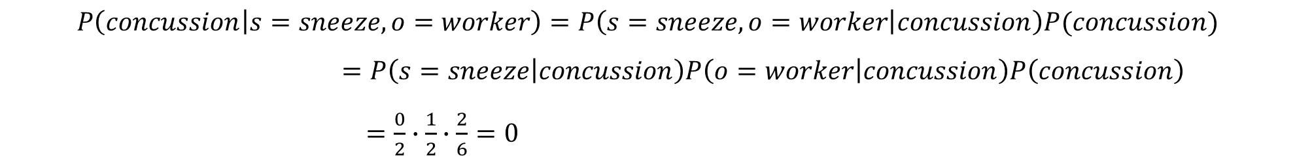
(Sneeze, Construction worker) Diagnosis ?
$$P\left(cold | s=sneeze,o=worker\right)=P\left(s=sneeze,o=worker | cold\right)P\left(cold\right)$$
$=P\left(s=sneeze | cold\right)P\left(o=worker | cold\right)P\left(cold\right)=\frac{2}{3}∙\frac{1}{3}∙\frac{2}{6}=\frac{2}{27}$
$$P\left(allergy | s=sneeze,o=worker\right)=P\left(s=sneeze,o=worker | allergy\right)P(allergy)$$
$$=P\left(s=sneeze | allergy\right)P\left(o=worker | allergy\right)P\left(allergy\right)=\frac{1}{1}∙\frac{0}{1}∙\frac{1}{6}=0$$
Over-fitting
$$P\left(concussion | s=sneeze,o=worker\right)=P\left(s=sneeze,o=worker | concussion\right)P(concussion)$$
$=P\left(s=sneeze | concussion\right)P\left(o=worker | concussion\right)P\left(concussion\right)$
$=\frac{0}{2}∙\frac{1}{2}∙\frac{2}{6}=0$
symptom | occupation | diagnosis
Sneeze | Nurse | Cold
Sneeze | Nurse | Allergy
Headache | Construction worker | Concussion
Headache | Construction worker | Cold
Sneeze | Lecturer | Cold
Headache | Lecturer | Concussion
Over-fitting
$$cold$$

